Slide 1
AIML Project

Slide 2
Title:
Simple Python-Based Sign Language Translator.

Slide 3
Project abstract:

Slide 4
Problem statement:
Development of a Sign Language Recognition System using Python.
Effective communication is vital for the hearing-impaired community, yet many face barriers due to the lack of understanding of sign language. This project aims to create a Sign Language Recognition System that translates sign gestures into text or speech, facilitating better communication.
Accurately recognizes hand gestures corresponding to a specific sign language (e.g., American Sign Language). Provides a real-time feedback and translation of recognized gestures.

Slide 5
Algorithm:
Data Collection: Use a dataset of hand gesture images for A-Z.
Image Preprocessing: Resize and normalize images for training.
Model Training: Train a Convolutional Neural Network (CNN) on the gesture dataset.
Real-Time Translation: Capture hand gestures using a webcam and classify them.
Output: Display the translated text on the screen.

Slide 6
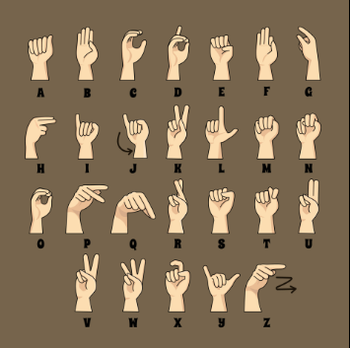
Expected output:
Recognition algorithm include achieving an accuracy of 90% or higher on the test dataset, with high precision and recall values. The model should demonstrate robustness by effectively generalizing to unseen data and recognizing variations in signing styles. It should enable real-time recognition with providing users with immediate feedback. Visual insights like confusion matrices and training curves will highlight performance and learning trends. Lastly, the system should be easily integrable into applications and scalable for multiple users without performance issues.

Slide 7
POSTER:

Slide 8
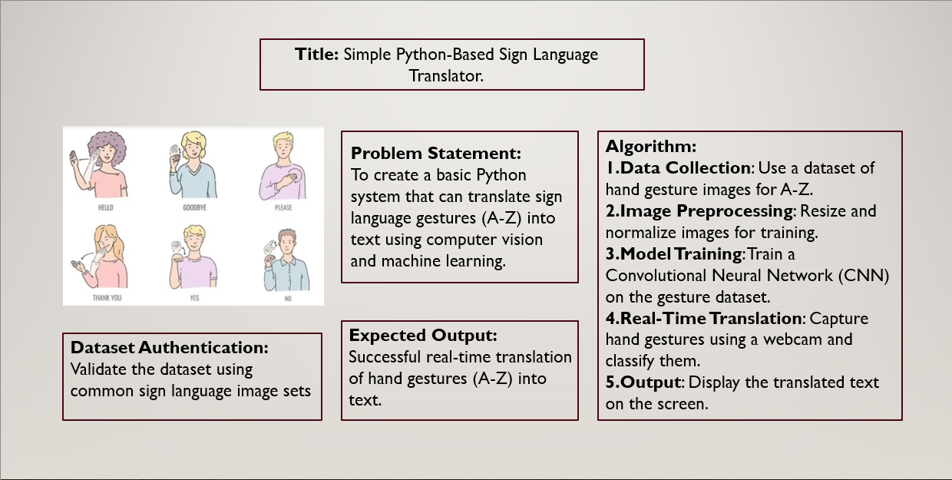

Slide 9
Thank you

